Slide 1
Bites, Bytes, and Insights
Navigating Animal Bite Data for Louisville, KY
Max Silverstein
Notes:
Good afternoon! I’m pleased to present my project: Bites, Bytes, and Insights, where I will be exploring my findings on animal bites here in louisville between 2010 and 2017. I will share my findings and recommendations to help mitigate these terrifying incidents as much as possible with the tools available to the city

Slide 2
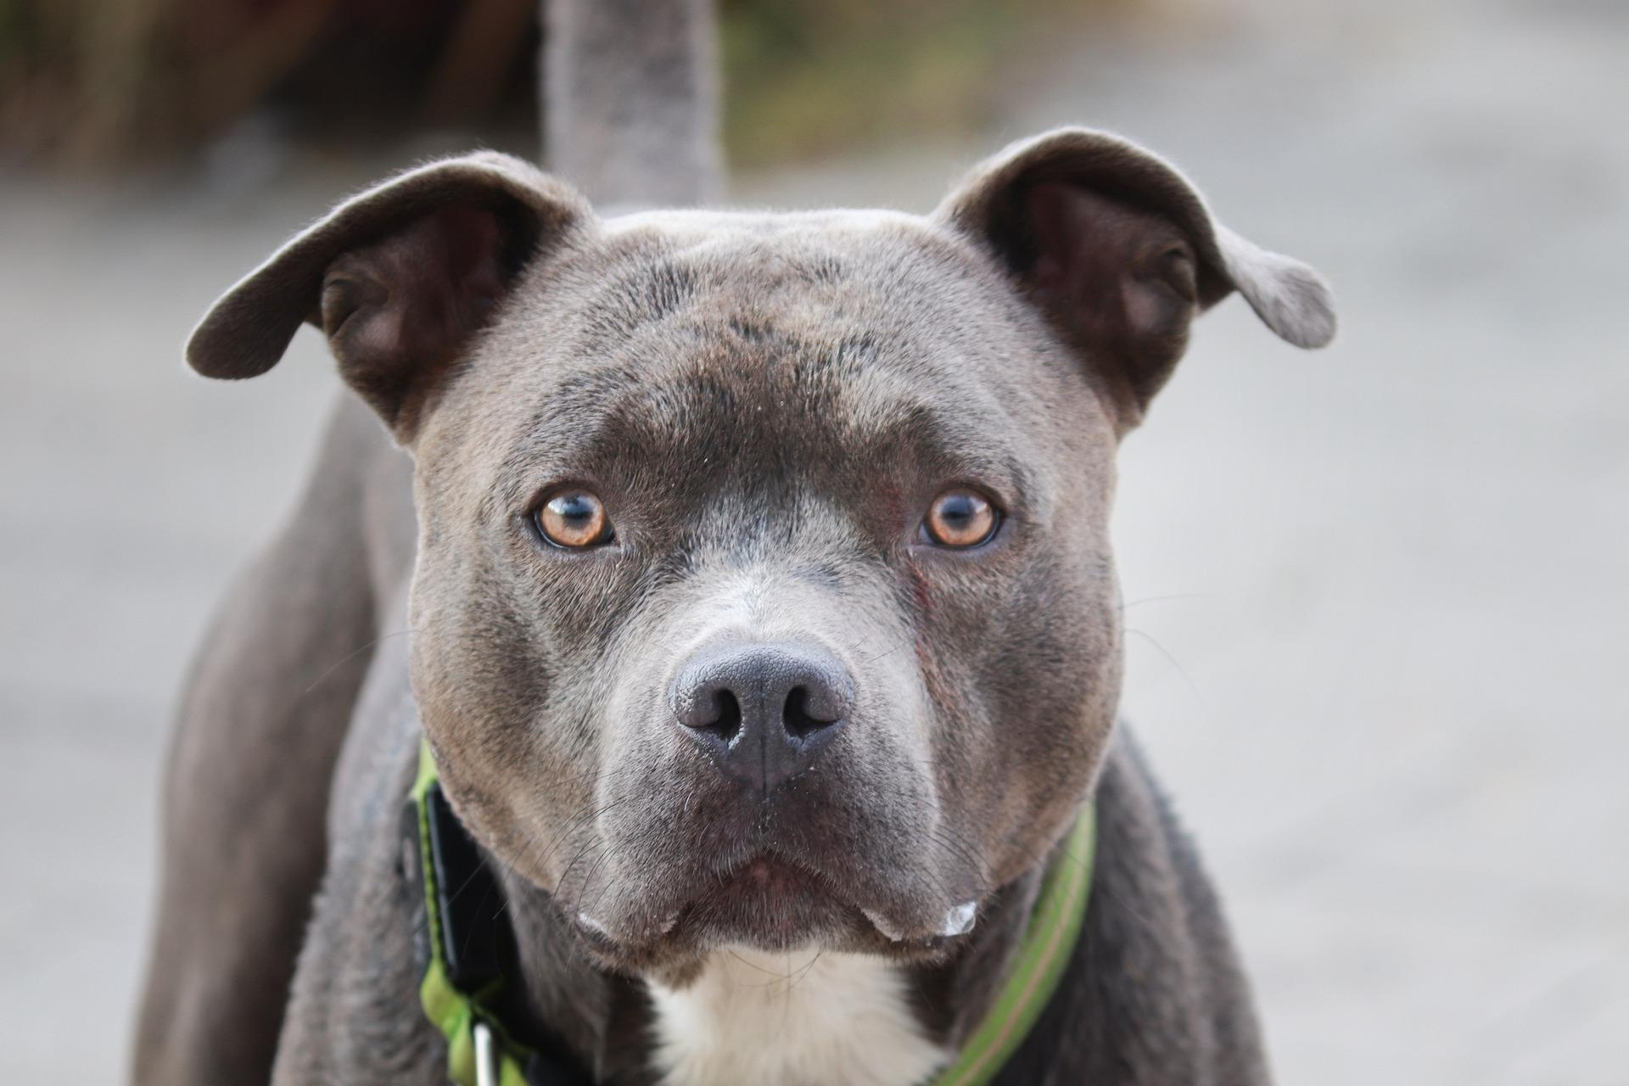
What do we do about animal bites?
Notes:
Imagine walking through a Louisville neighborhood on a beautiful summer day. The sun is shining, and everything seems at peace. Then without warning, a dog charges around the corner, leaps toward you and latches onto your arm. Pain, terror, shock, and chaos ensue as your neighbors fend the animal off and get you to the hospital. Although thankfully rare, animal attacks are dangerous, terrifying, and can even be life-threatening, especially to children. Protecting both people and animals from these dangerous encounters is a matter of public safety, and demands we use the tools at our disposal to mitigate these emergencies.
To that end, I have analyzed (x) years of animal bite data provided by the city of Louisville to gain insights into animal bite patterns, and to produce recommendations for the city to keep everyone as safe as possible, whether they have 2 legs or 4.

Slide 3
Executive Summary
Average 1114 bites per year
Notes:
Average 1114 bites per year
80% Dogs, 18% Cats
Most bites in Summer, fewest in Winter
Males bite more than females
Pit bulls have the most bite reports among dogs
Most bites are below the neck
More information about the animals and victims would be useful

Slide 4
Executive Summary
Average 1114 bites per year
80% Dogs, 18% Cats
Notes:
Average 1114 bites per year
80% Dogs, 18% Cats
Most bites in Summer, fewest in Winter
Males bite more than females
Pit bulls have the most bite reports among dogs
Most bites are below the neck
More information about the animals and victims would be useful

Slide 5
Executive Summary
Average 1114 bites per year
80% Dogs, 18% Cats
Most bites in Summer, fewest in Winter
Notes:
Average 1114 bites per year
80% Dogs, 18% Cats
Most bites in Summer, fewest in Winter
Males bite more than females
Pit bulls have the most bite reports among dogs
Most bites are below the neck
More information about the animals and victims would be useful

Slide 6
Executive Summary
Average 1114 bites per year
80% Dogs, 18% Cats
Most bites in Summer, fewest in Winter
Males bite more than females
Notes:
Average 1114 bites per year
80% Dogs, 18% Cats
Most bites in Summer, fewest in Winter
Males bite more than females
Pit bulls have the most bite reports among dogs
Most bites are below the neck
More information about the animals and victims would be useful

Slide 7
Executive Summary
Average 1114 bites per year
80% Dogs, 18% Cats
Most bites in Summer, fewest in Winter
Males bite more than females
Pit bulls have the most bite reports among dogs
Notes:
Average 1114 bites per year
80% Dogs, 18% Cats
Most bites in Summer, fewest in Winter
Males bite more than females
Pit bulls have the most bite reports among dogs
Most bites are below the neck
More information about the animals and victims would be useful

Slide 8
Executive Summary
Average 1114 bites per year
80% Dogs, 18% Cats
Most bites in Summer, fewest in Winter
Males bite more than females
Pit bulls have the most bite reports among dogs
Most bites are below the neck
Notes:
Average 1114 bites per year
80% Dogs, 18% Cats
Most bites in Summer, fewest in Winter
Males bite more than females
Pit bulls have the most bite reports among dogs
Most bites are below the neck
More information about the animals and victims would be useful

Slide 9
Executive Summary
Average 1114 bites per year
80% Dogs, 18% Cats
Most bites in Summer, fewest in Winter
Males bite more than females
Pit bulls have the most bite reports among dogs
Most bites are below the neck
More information about the animals and victims would be useful
Notes:
Average 1114 bites per year
80% Dogs, 18% Cats
Most bites in Summer, fewest in Winter
Males bite more than females
Pit bulls have the most bite reports among dogs
Most bites are below the neck
More information about the animals and victims would be useful

Slide 10
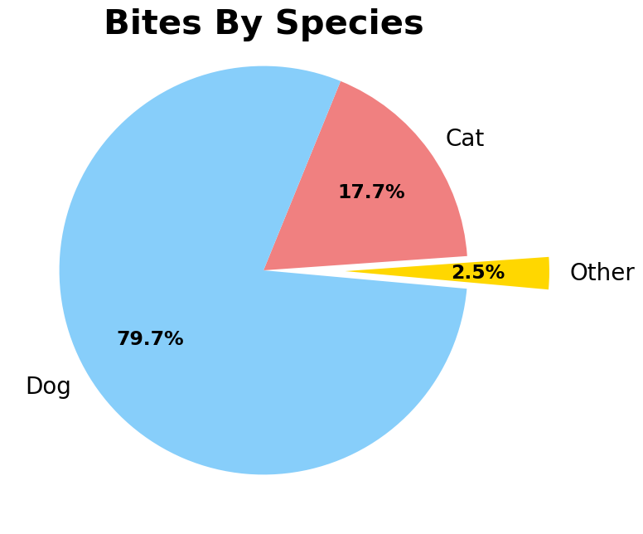
Which animals are biting?
Notes:
If we break down animal bites by species, we find that Dogs make up the overwhelming majority of bite reports, at nearly 80%. About another 18% of bites are from cats, while all other species combined make up the remaining 2.5%. This group includes bats (most common), raccoons, a couple of rabbits, and one particularly aggressive skunk.
In looking at this breakdown, it is vitally important to note that the bite reports generated here may not reflect the true proportion of animal bites; depending on circumstances, some bites may not be reported. For example, an individual may not be concerned with a bite perceived as less severe, and could simply clean and dress the wound themselves; we would therefore expect larger animals to be overrepresented to some degree over smaller animals. The other major caveat is that we currently lack any kind of animal census data, whether that be registered pets or livestock, or estimates of wild animal populations.
That being said, we can see here that nearly all reported bites result from the two most popular household pets: cats and dogs. Given that many breeds of dog tend to be physically larger than cats, we would expect dog bites to be reported more than cat bites above and beyond either species propensity to bite. In any event, it is clear that bite prevention and mitigation interventions should naturally focus on cats and especially dogs.

Slide 11
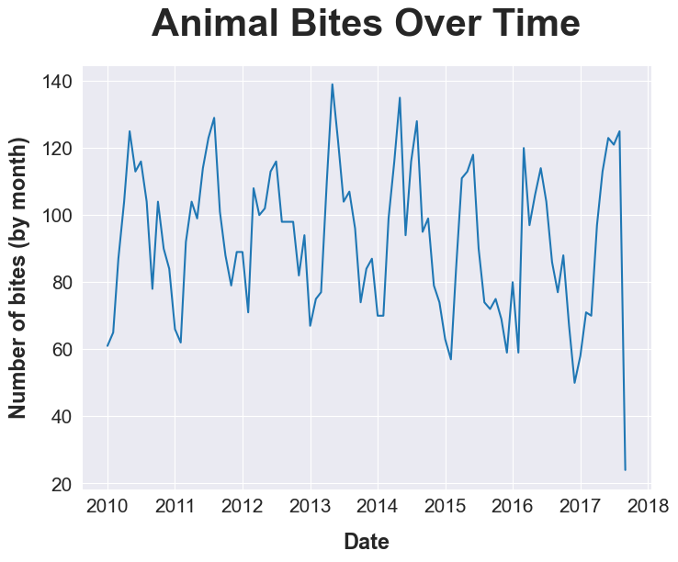
When are animals biting?
Notes:
If we examine animal bite data over time, we can identify some interesting patterns. First, there is clearly a seasonal pattern to animal bites, which we will examine more closely momentarily. The second feature I wish to point out is that bite patterns remain fairly consistent over time. While annual bites noticeably dropped in 2015, the 2016 bite rate remained fairly in line with previous years.
Note that the apparent dropoff in 2017 is due to the data collection ending in the beginning of September of that year.

Slide 12
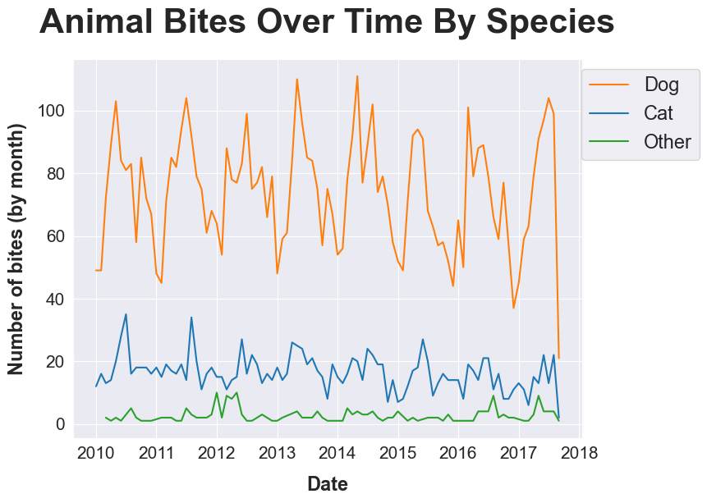
When are animals biting? Pt. 2
Notes:
If we break down yearly trends in animal bites by species, we can see evidence for seasonal patterns in both dogs and cats, although seasonality in cat bites is less striking than it is in dogs. For other species, not enough data is available to comment one way or the other on seasonality.
Moreover, while dog bites remain fairly consistent, neither trending noticeably upwards or downwards, cat bites seem to trend down over time.

Slide 13
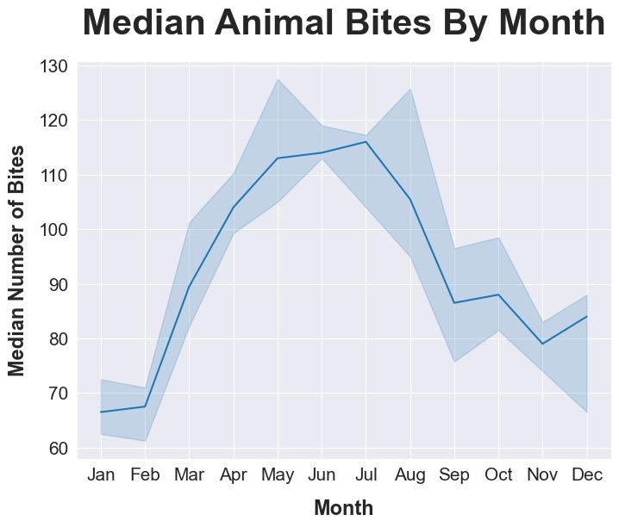
Which months do animals bite more?
Notes:
To examine the seasonal pattern more closely here we have the median animal bites broken down by month, with a 50% interval represented by the error margin. We can see that the bite rate rises in the spring months, peaks in the summer months, and declines in the autumn months.
There are a number of plausible factors that could help explain this pattern. The warmer spring and summer months see more people spending time outdoors and socializing, which would in turn lead to increased contact with both wild animals and unfamiliar pets, both of which would be expected to correlate with more animal bite incidents. Another factor that should be examined is the school year, as summer vacation means more children will be in contact with animals. As such, possible preventative interventions could include education for both children and their parents on how to exercise proper caution and behavior around wild and unfamiliar animals to minimize the risks of an attack. That being said, more data and study would be required to evaluate the impact of such interventions, and are beyond the scope of this project.
One other possible association with the seasonal bite pattern could be mating seasons, where one would expect animals to be more aggressive and territorial. That being said, much of the data is driven by pet species, and pets in the United States are routinely desexed; it is therefore unclear what magnitude if any this behavior would have on overall bite patterns. Still, it could be worth further investigation.

Slide 14
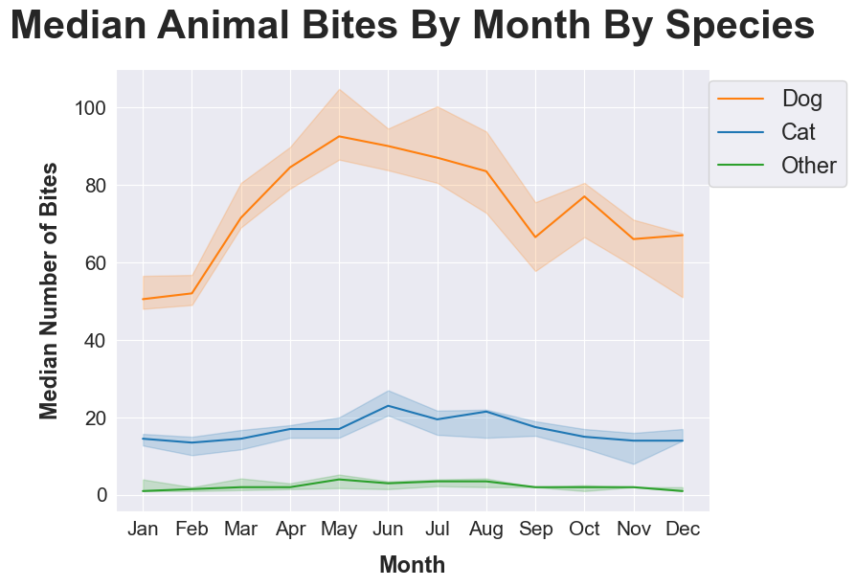
Which months do animals bite more? Pt. 2
Notes:
Separating median monthly bites by species, we see both dogs and cats have the overall seasonal behavior we identified for all animal bites, although it is somewhat less pronounced for cats than dogs. Other animals do not have enough bite data to see any sort of trend.

Slide 15
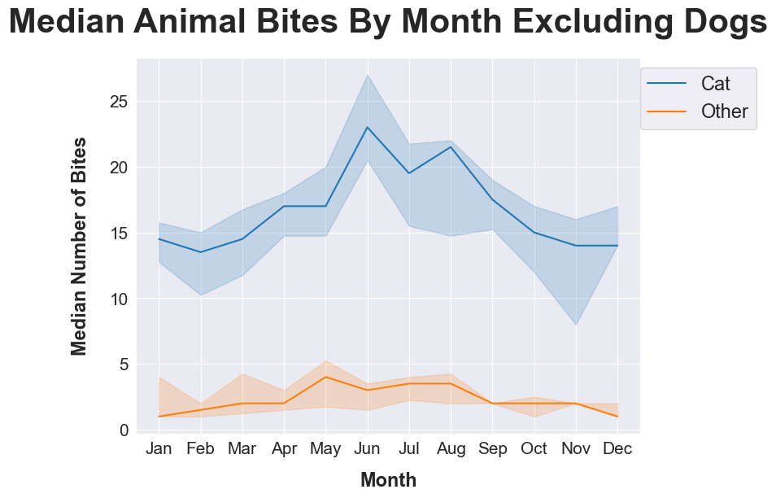
Which months do animals bite more? Pt. 3
Notes:
It could be hard to visualize the seasonal behavior of cat bites with the magnitude of dog bite behavior, so here is a version of the prior chart without dog bite data.

Slide 16
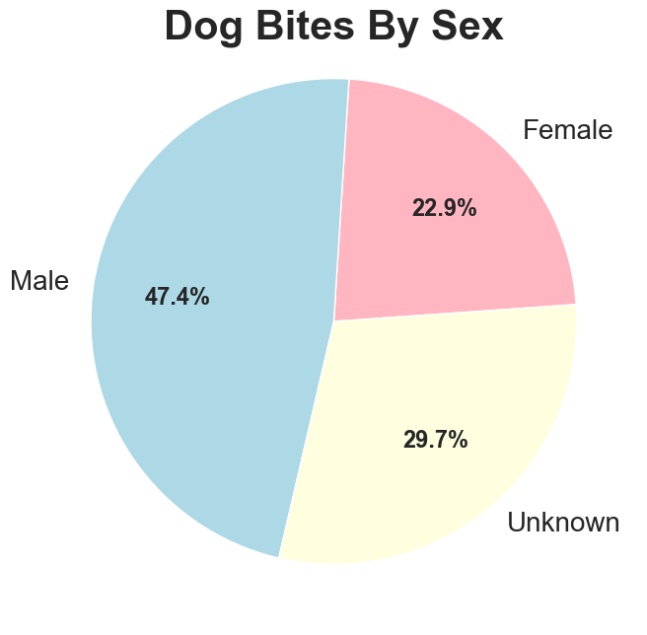
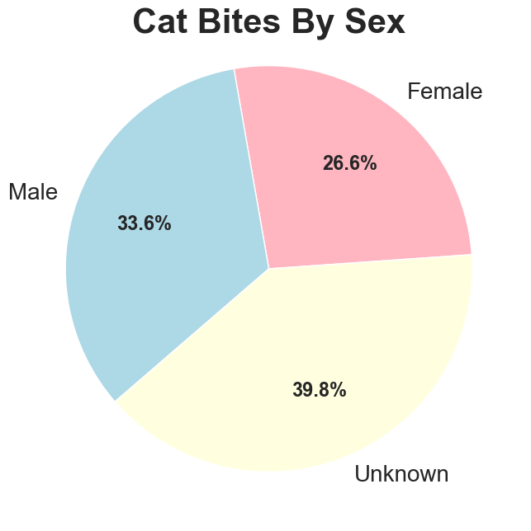
Which animal sexes bite more?
Notes:
Turning now to the sex of the animal, we see that bites by male dogs are reported at much higher rates than female dogs. Male cats also have more reported bites than female cats; however, this difference is less pronounced. Unfortunately, we lack a good amount of data on animal sex for dogs and especially cats; if this omission is not random, then it may skew the recorded proportion of male vs female bites.
In any event, this may be a useful indicator to help pet owners take extra precautions for their male pets to reduce biting behavior, whether through training, extra restraint, etc and particularly in stressful and unfamiliar situations.

Slide 17
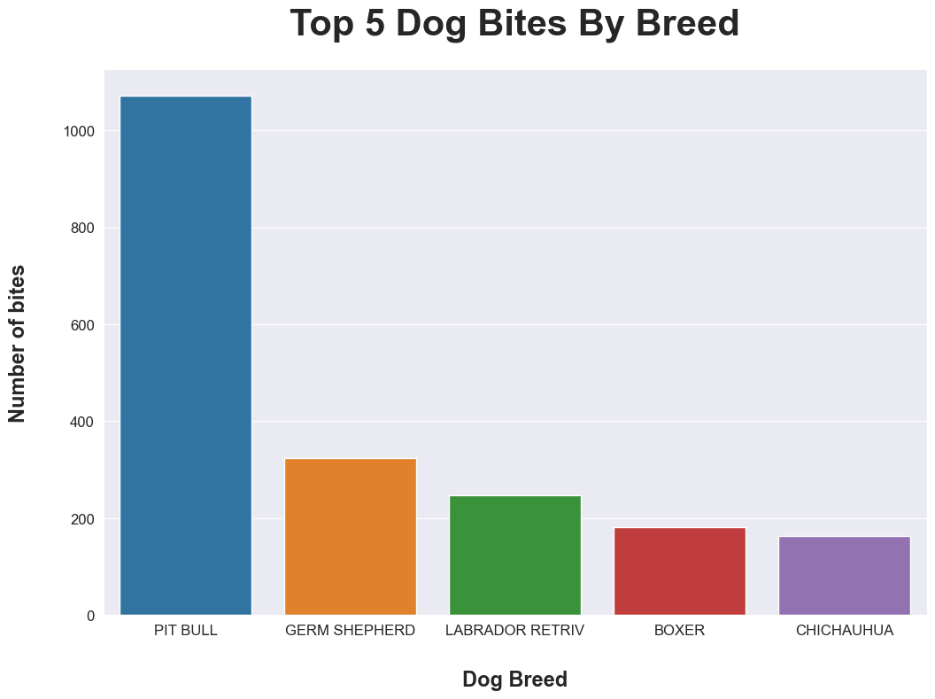
Which dog breeds bite more?
Notes:
Turning now to dog breed in particular, here we have the bite data for the top 5 most common breeds by bite incidence (where dog breed was recorded). As we can see, Pit Bulls have more than double the bites recorded of any other breed in this dataset.
As mentioned when examining bites by species, a number of factors need to be considered when examining these figures. A lack of population data for comparison becomes a significant issue here, as without this data, we cannot make firm conclusions about whether or not a particular breed is more or less prone to biting. A popular breed such as the labrador retriever is more likely to be represented in bite data simply by virtue of being more numerous in the community. This is also a category where bite severity becomes an issue; a bite from a larger, more muscular dog will naturally cause more damage than a bite from a smaller dog, and is therefore more likely to result in the presence of law enforcement and/or hospital care.
That being said, the sheer quantity of pit bull bites on this list cannot be ignored. It may be necessary to require additional precautions from owners of these pets in order for them to be legally owned, both for their own safety and the safety of those around them. In any event, it would be useful for the city to record data on bite severity, in addition to providing estimates on dog populations by breed, to help examine the true nature of these bites and produce more useful recommendations.
Pit bulls, german sheperds, and boxers are known for their powerful bites. Labrador retrievers are one of the most popular breeds, and chihuahuas are known for their aggressive dispositions.

Slide 18
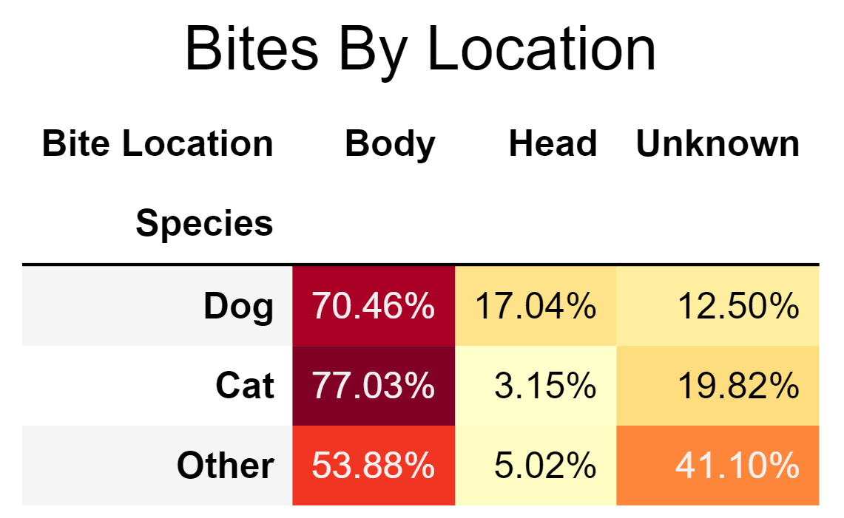
Where do animals bite?
Notes:
Next, we look at where animals bite their victims. This data set distinguishes between two areas on the victim: the head and the body. Bites on the head are of particular concern in the case of children: since they are lower to the ground, they are more vulnerable to a dangerous head or neck bite from an animal.
As we can see here, the overwhelming majority of bites occur on the body, at least where the data is available. Of the three categories of animals, dogs have the highest reported incidence of head and neck bites

Slide 19
Key Statistics and Findings
Average Annual Bites: 1114 Total, 880 Dogs, 200 Cats
Notes:
Seasonal Mann-Kendall test: No trend
ANOVA: Clear differences between seasons
Chi Square: head vs body over species

Slide 20
Key Statistics and Findings
Average Annual Bites: 1114 Total, 880 Dogs, 200 Cats
Average Summer Bites: 332 Total, 261 Dogs, 63 Cats
Notes:
Seasonal Mann-Kendall test: No trend
ANOVA: Clear differences between seasons
Chi Square: head vs body over species

Slide 21
Key Statistics and Findings
Average Annual Bites: 1114 Total, 880 Dogs, 200 Cats
Average Summer Bites: 332 Total, 261 Dogs, 63 Cats
Average Winter Bites: 203 Total, 158 Dogs, 40 Cats
Notes:
Seasonal Mann-Kendall test: No trend
ANOVA: Clear differences between seasons
Chi Square: head vs body over species

Slide 22
Key Statistics and Findings
Average Annual Bites: 1114 Total, 880 Dogs, 200 Cats
Average Summer Bites: 332 Total, 261 Dogs, 63 Cats
Average Winter Bites: 203 Total, 158 Dogs, 40 Cats
No evidence for changing trends in bites over time
Notes:
Seasonal Mann-Kendall test: No trend
ANOVA: Clear differences between seasons
Chi Square: head vs body over species

Slide 23
Key Statistics and Findings
Average Annual Bites: 1114 Total, 880 Dogs, 200 Cats
Average Summer Bites: 332 Total, 261 Dogs, 63 Cats
Average Winter Bites: 203 Total, 158 Dogs, 40 Cats
No evidence for changing trends in bites over time
Clear evidence of seasonal behavior across species (p < 0.0001)
Notes:
Seasonal Mann-Kendall test: No trend
ANOVA: Clear differences between seasons
Chi Square: head vs body over species

Slide 24
Key Statistics and Findings
Average Annual Bites: 1114 Total, 880 Dogs, 200 Cats
Average Summer Bites: 332 Total, 261 Dogs, 63 Cats
Average Winter Bites: 203 Total, 158 Dogs, 40 Cats
No evidence for changing trends in bites over time
Clear evidence of seasonal behavior across species (p < 0.0001)
Dogs bite the head more than cats (p < 0.0001)
Notes:
Seasonal Mann-Kendall test: No trend
ANOVA: Clear differences between seasons
Chi Square: head vs body over species

Slide 25
More Data Is Needed
How severe was the bite?
Notes:
Data scientists asking for more and more data has become cliche at this point. That said, it is always true that more information will always help reveal the bigger picture and improve the specificity of the recommendations and ideas that we can provide. Fortunately, there is a lot of data that can be collected as a matter of course as officials process the incident reports that follow a bite.
First, how severe was the bite? This can be a simple qualitative assessment of how grave the injury was, and will help establish which animals and which scenarios present the greatest risk to public safety.

Slide 26
More Data Is Needed
How severe was the bite?
What species is the bite victim?
Notes:
Next, what species is the bite victim? Knowing if it was a human or if it was another animal will help with educating pet owners to avoid situations that increase the risk of bites.

Slide 27
More Data Is Needed
How severe was the bite?
What species is the bite victim?
Is the biting animal a pet or is it wild?
Notes:
Is the biting animal a pet or is it wild? How animal control can respond can be informed by this information

Slide 28
More Data Is Needed
How severe was the bite?
What species is the bite victim?
Is the biting animal a pet or is it wild?
Is the victim a child, adolescent, or adult?
Notes:
What is the age group of the victim? While an exact age could give rise to privacy concern, simply stating if the individual was a child, adolescent or adult would provide sufficient information on which groups are most at risk of animal bites while minimizing risks to privacy

Slide 29
More Data Is Needed
How severe was the bite?
What species is the bite victim?
Is the biting animal a pet or is it wild?
Is the victim a child, adolescent, or adult?
Rabies testing
Notes:
Unfortunately, the current dataset is lacking in both records of rabies testing and following up on results. This is important for assessing the risk of dangerous disease transmission from animal bites, and should be rectified as soon as possible

Slide 30
More Data Is Needed
How severe was the bite?
What species is the bite victim?
Is the biting animal a pet or is it wild?
Is the victim a child, adolescent, or adult?
Rabies testing
Pet Census
Notes:
A pet census is the one item that would not be collected from incident reports, and would require extra time and resources to coordinate with the community to gather. It would be useful for contextualizing bite risks as a function of species, sex, and breed. However, those benefits would need to be balanced against the time and labor available for this issue.

Slide 31
Any questions?
Notes:
We have good values

